Slide 1

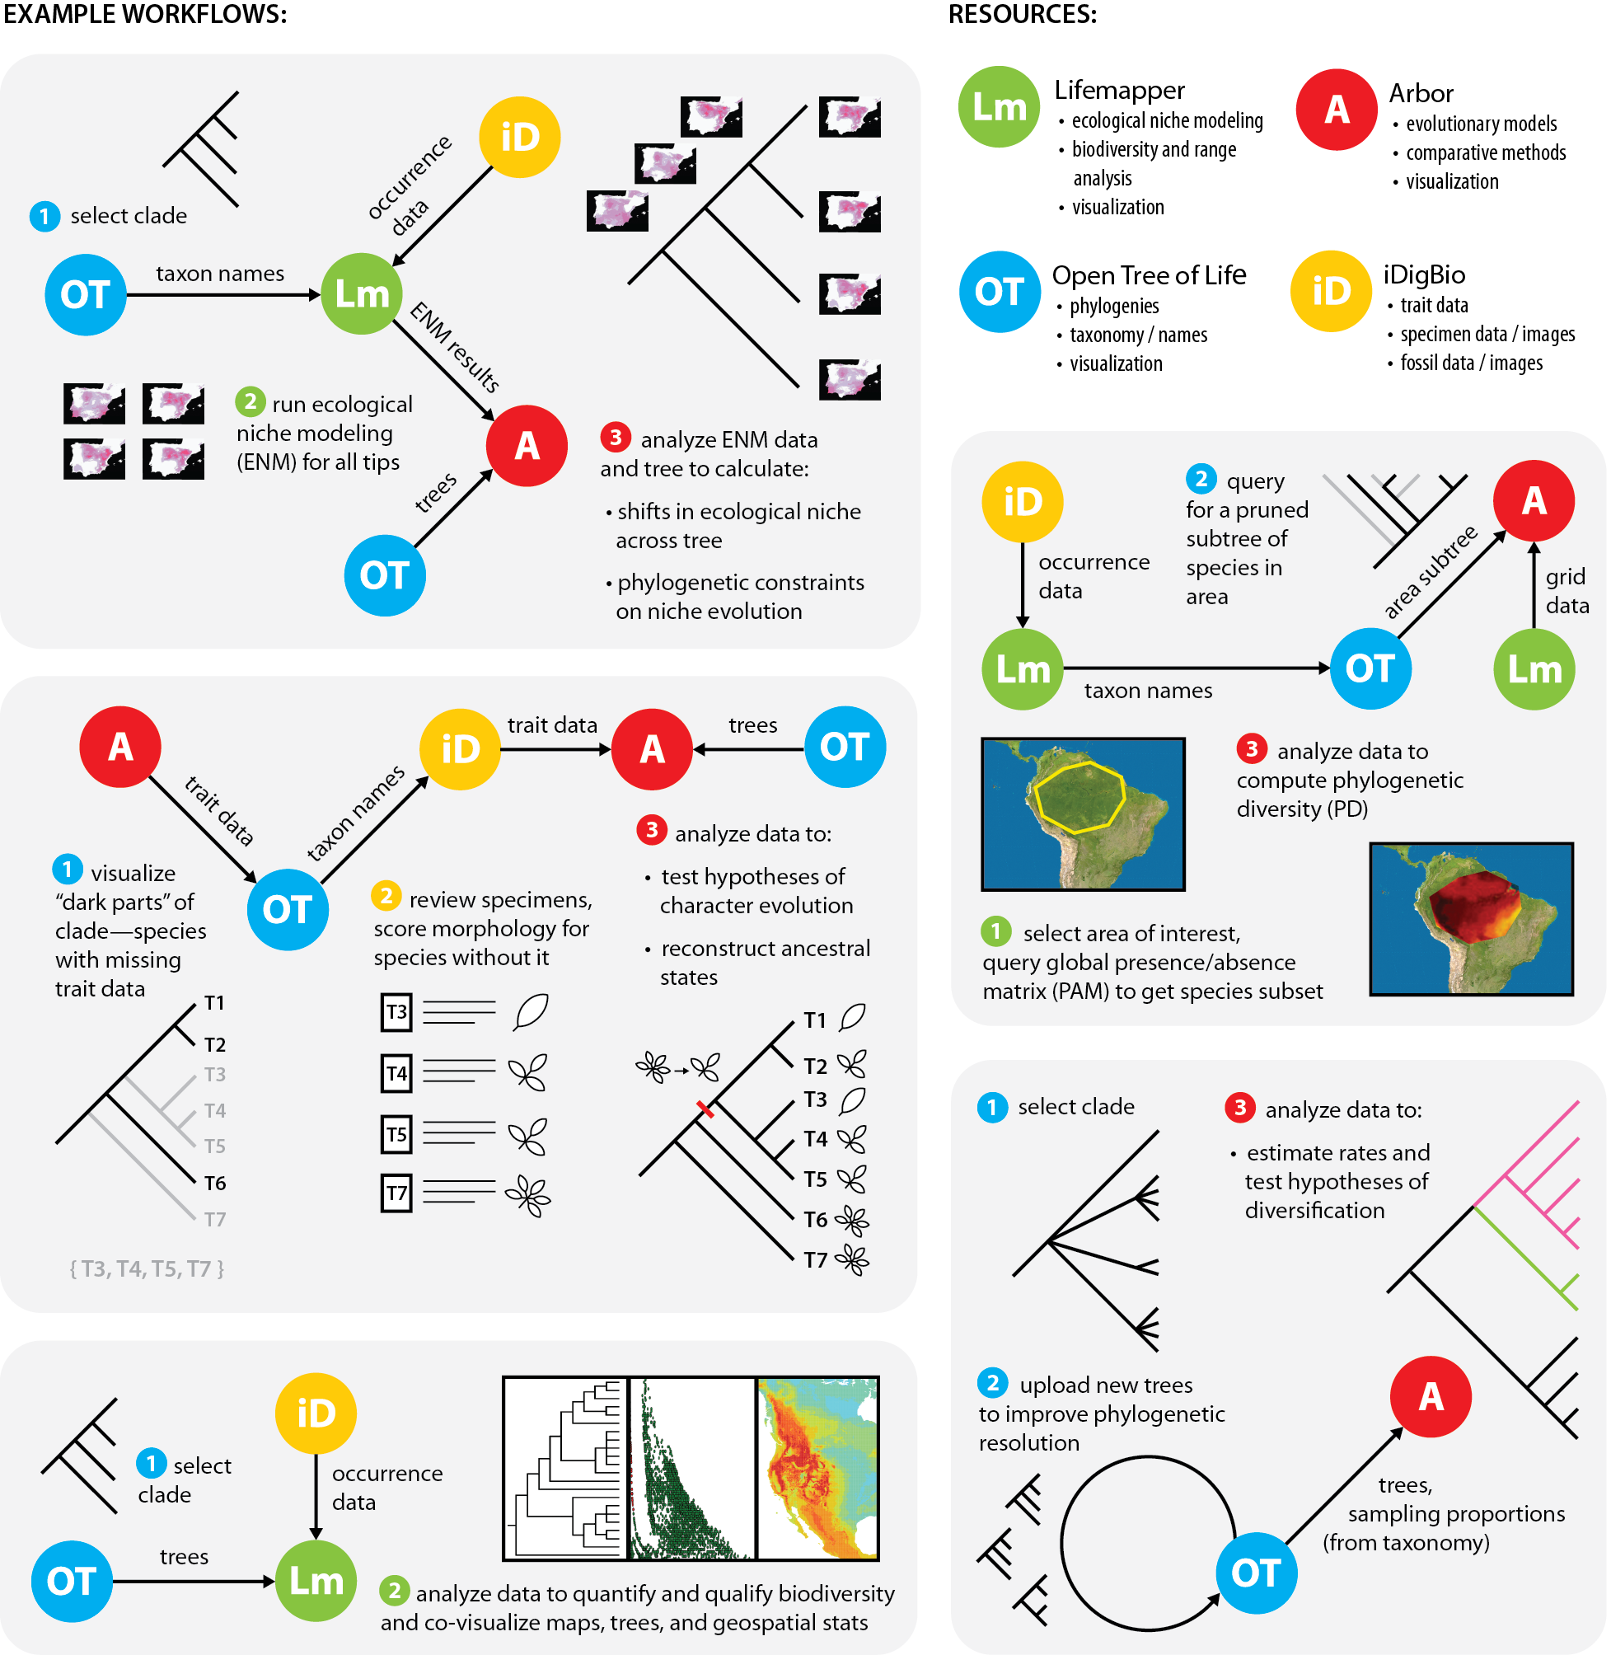

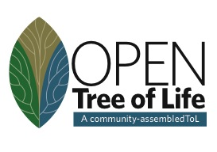

Connecting Specimens, Trees, Tools
Linking Heterogeneous Data:
ABI Innovation: BiotaPhy Project
Connecting resources
to enable large-scale biodiversity analyses
D. Soltis, P. Soltis, J. Fortes,
J. Beach, J. Soberon, S. Smith
Analytical Tools

Slide 2
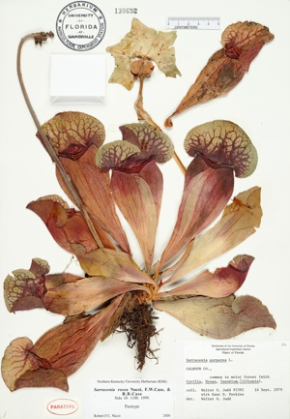
Label Data
Scientific name
Date
Collector
Location – state, county,
specific site,
GPS coordinates
Associated species

Slide 3

Trees
da shu

Slide 4
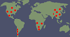



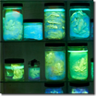



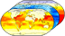
Lifemapper: Species Distribution Modeling
Species Occurrence Data
Predicted Habitat
Environmental Data
Notes:
We have 2 primary sets of tools, and a third almost ready for publication–
the first is Species Distribution Modeling
Lifemapper calculates predicted habitat models using occurrence and environmental data and an OS software framework called openModeller, created by CRIA (Reference Center on Environmental Information) in Brazil
openModeller currently implements 11 algorithms for calculating SDM, each with multiple parameters to tune the calculations and can be extended to include new algorithms
Our primary data source for specimen occurrence data is GBIF. GBIF gives us a copy of their cache approximately once a month. These data are organized by scientific name and available through LM services for download and modeling. Alternatively researchers can upload their own datasets for SDM computation
Environmental layers are also served through LM services, including WorldClim elevation and bioclimatic variables and the same bioclimatic variables calculated from predicted future climate values from global climate models

Slide 5
Connecting Specimens, Trees, Tools
5 Possible Workflows
Analytical Tools
Analytical Tools

Slide 6
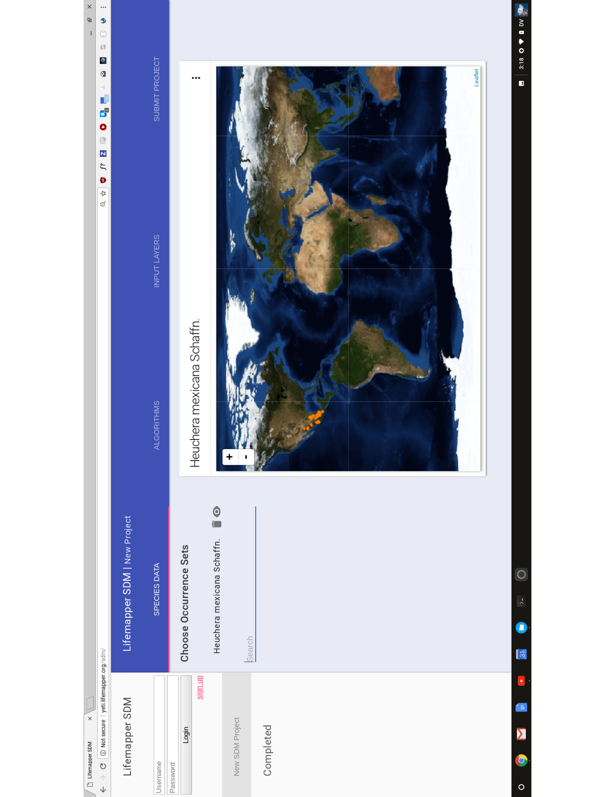
BiotaPhy: Web Interface for Integrative Analysis

Slide 7
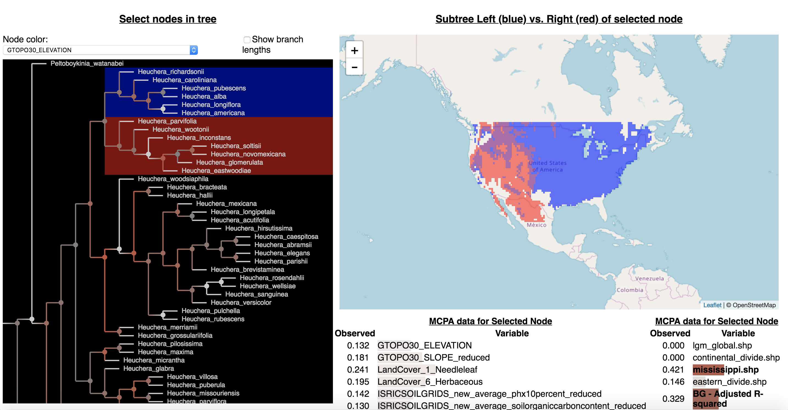
BiotaPhy: Web Interface for Integrative Analysis

Slide 8
Connecting Trees, Specimens, Tools
Ancestral Niche
Analytical Tools
C. Hinchliff

Slide 9


Saxifragales: Ancestral Niche
Temperature variables (e.g., mean annual temperature) suggest a temperate origin...
Shifts out of a state are rare
Hot
Ryan Folk
Cold

Slide 10
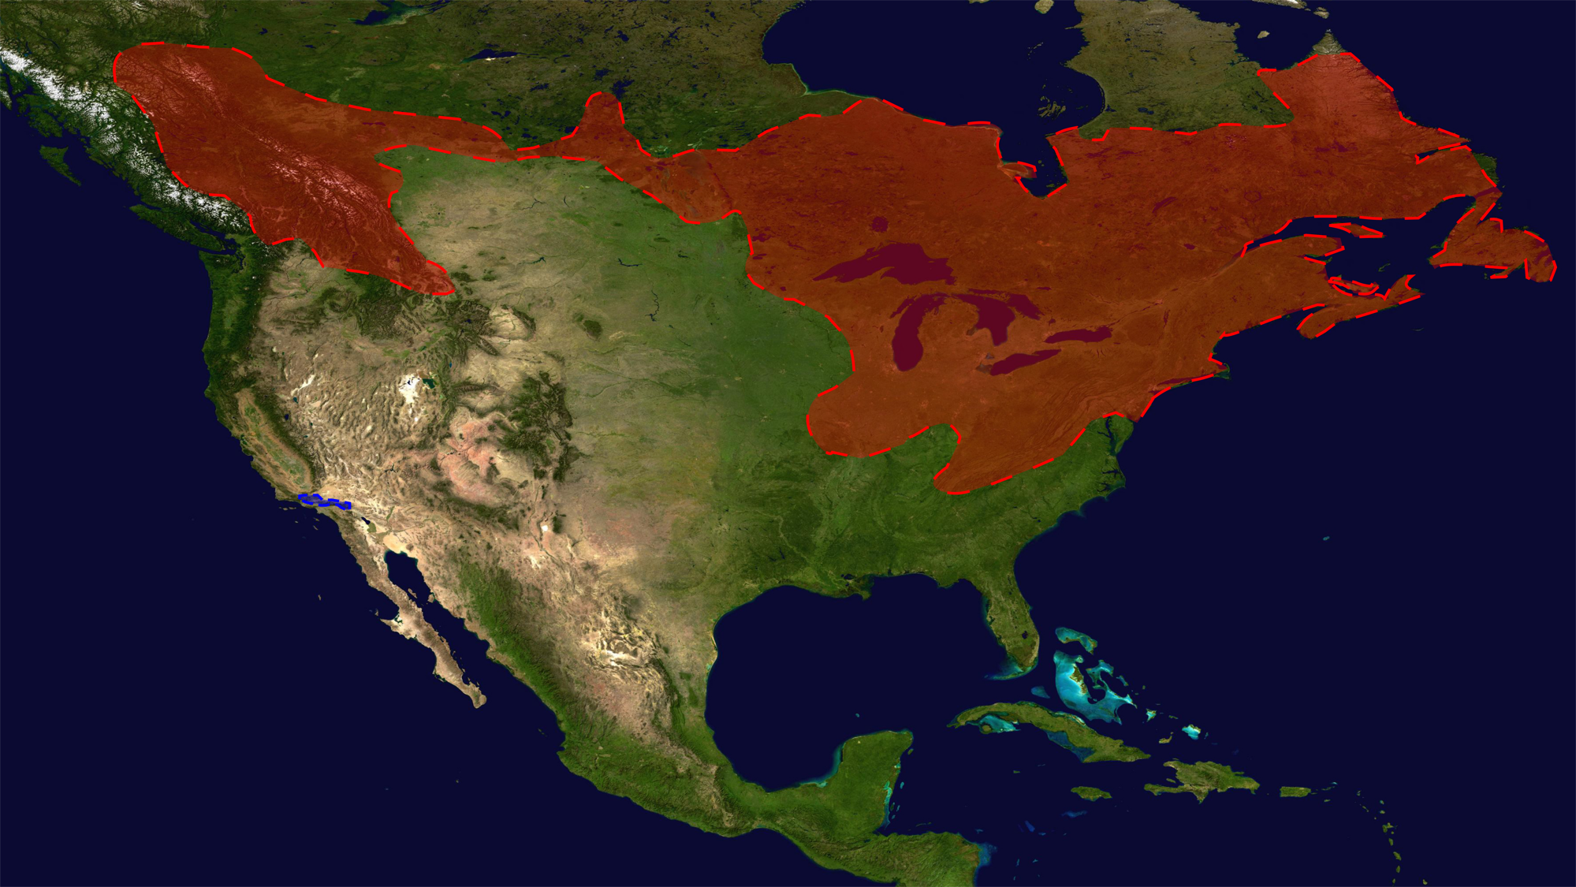
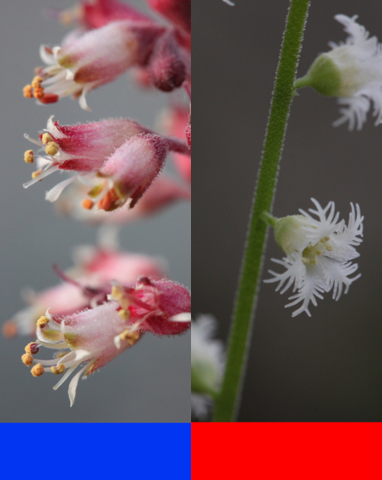
Solving a Hybridization Puzzle
cpDNA capture
Heuchera
Mitella
Ryan Folk

Slide 11
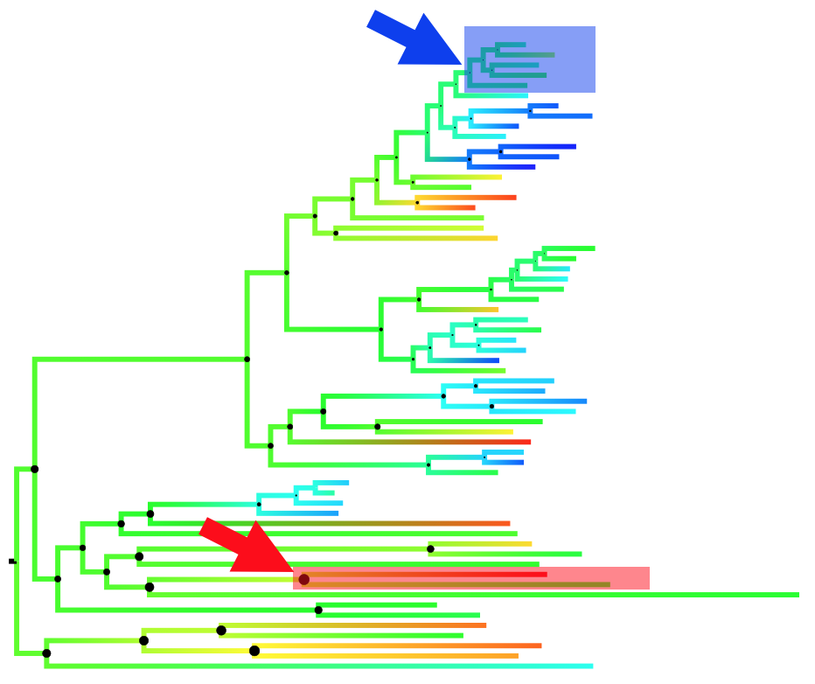
Hybridization & Ancestral Ecological Niche-Space
Heuchera
Mitella
Notes:
Reconstructed the ancestral niche for the clades of heuchera and Mitella—35 layers-custom scripts, Bayestraits….ryan can provide details

Slide 12

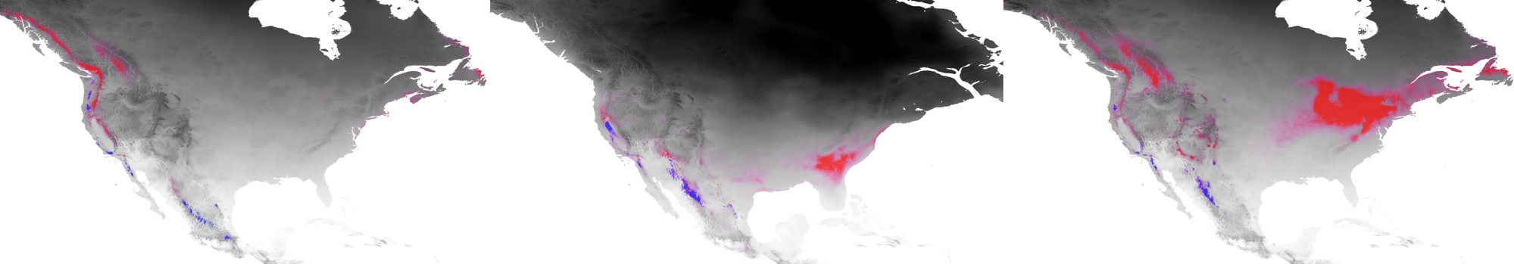

Ancestral Niche Reconstruction
Heuchera
Heuchera
Mitella
Ryan Folk
Notes:
Then used paleoclimatic projections –worldclim—to assess possible niche overlap through time

Slide 13
Spatial Phylogenetics

Slide 14
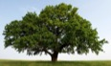
Phylogenetic Diversity (PD):
how much of the Tree of Life is present in an area?
Oaks
Vs.

Slide 15
Phylogenetic Diversity (PD) in Florida
with Hand Curated Tree
Species list at each pixel
Generated from niche models
8,045 pixels/communities
16 km² per pixel

Slide 16
Phylogenetic Diversity
PD = proportion of tree present in cell
Notes:
Both are highly correlated with each other, and with the alpha diversity map too. Ultramatric is generally lower over the landscape.
This might be due to a low proportion of short deep branches in the tree. These lengthen the overall

Slide 17
PD – Genera of China Angiosperms

Slide 18
Biotaphy 2: Goals
BiotaPhy Platform: community biodiversity gateway for data- intensive science
Increase accessibility and use of Open Tree of Life, iDigBio, and Lifemapper
A sustainable, long-term, biodiversity community infrastructure
Workshops

Slide 19
Biotaphy 2 Workflows

Slide 20
BiotaPhy: Web Interface for Integrative Analysis

Slide 21
BiotaPhy: Web Interface for Integrative Analysis

